Slide 1
Impact of various crimes on GSDP of states in India
Submitted by:
Shivendra sSingh Chauhan (shivendrac05@iimamritsar.ac.in)
Nishnath A S (​anishnath05@iimamritsar.ac.in)
Mohith P (​pmohith05@iimamritsar.ac.in)

Slide 2
Data
Crimes recorded in individual states from 2001 to 2011
Sources: Ministry of Home Affairs reports on Crime in India, official database of Indian Government
GSDP for various states during the same time period
Inflation for the same period

Slide 3
Classification of crimes
Murder / Homicide: Murder, attempt to commit murder, Culpable homicide not amounting to murder.
Rape: Rape, Custodial Rape, Other Rapes
Kidnapping & Abduction: Kidnapping & Abduction, Kidnapping and Abduction of Women and Girls, Kidnapping and Abduction of Others.
Dacoity/Robbery/Theft: Dacoity, Preparation and assembly to commit Dacoity, Robbery, Burglary, Theft, Auto Theft, Other Theft.
Riots
Criminal Breach of Trusts
Cheating
Counterfeiting
Arson
Hurt/Grievous Hurt
Assault against women: Dowry death, Cruelty by husband or his relatives, Assault on woman with intent to outrage her modesty, Insult to the modesty of women and Importation of girls from foreign country;
Causing Death by Negligence
Other IPC crimes: Abetment of suicide, Exposure & Abandonment, Infanticide and foeticide etc.

Slide 4

Types of data
This is panel data
The basic regression model for a Panel Data is
y_{it} = b_{0it} + b_{1it}*x_{1it} + b_{2it}* x_{2it} + ……….. + b_{kit}* x_{kit} + a_{i} + L_{t} + error_{it}
where y_{it} is the dependent variable for i^{th} cross sectional unit at t^{th} time unit.
b_{kit} is the coefficient of k^{th} independent variable in the model related to i^{th} cross sectional unit and t^{th} time unit.
error_{it} is the error term related to i^{th} cross sectional unit at t^{th} time unit.

Slide 5
Assumptions:
2001 was considered as a base year for states GSDP.
Population was available only for years 2001,2011. So a linear increase in population is assumed between 2001 and 2011 to calculate per capita crime rate.
2001 year was excluded from the data as the growth rate was calculated from 2002.
Inflation was taken into account as it has a significant effect on Growth rate.
Data for 3 states was not available, so they were excluded from the data.
Data cleaning:
Data for various crimes is collected from the database and grouped together based on the nature of the crime and various laws applicable to that.
All the other crimes that come under IPC were put under separate categories.
Per Capita crime rate is calculated by dividing the crime numbers by population of the state.
Percentage growth rate of nominal GSDP of states is calculated on a yearly basis.

Slide 6
Dependent variable
Financial Growth is the dependent variable and it is characterized as GDP growth.
GDP is the financial estimation of the apparent multitude of finished goods and services produced by all the resident producers inside the country, usually calculated on yearly basis
Gross domestic product growth is the yearly rate development pace of GDP, The data is obtained from The Government of India database which is considered as a dependable one and which gives an enormous number of perceptions, over a huge timeframe.

Slide 7
Pooled OLS method
In this method, we assume that there is no individuality between the States/UT’s. We are pooling all the observations together for running the regression. We will apply a simple OLS method.
GDPgrowthrate _{it} = b₀ + b_{1*}Inflation _{it} + b₂*MurderHomicidepercapita _{it} + b₃*RAPEpercapita _{it} + b₄*KIDNAPPINGandABDUCTIONpercapita _{it} + b₅*DACOITYRobberyTheftpercapita _{it} + b₆*RIOTSpercapita _{it} + b₇*CRIMINALBREACHOFTRUSTpercapita _{it} + b₈*CHEATINGpercapita _{it} + b₉*COUNTERFIETINGpercapita _{it} + b₁₀*ARSONpercapita _{it} + b₁₁*HURTGREVIOUSHURTpercapita _{it} + b₁₂*ASSAULTONWOMENpercapita _{it} + b₁₃*CAUSINGDEATHBYNEGLIGENCEpercapita _{it} + b₁₄*OTHERIPCCRIMESpercapita _{it} + error _{t}

Slide 8
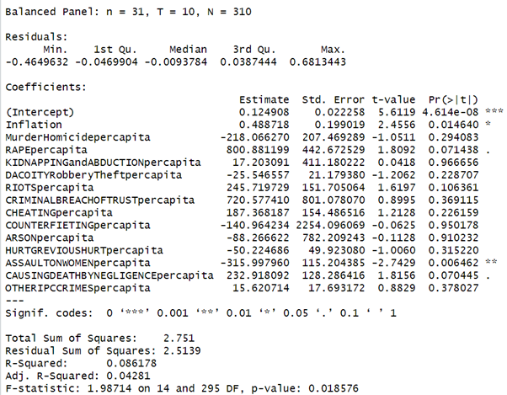
Results
The R squared value of the model is 0.086178 or 8.618%. The p value of the model is 0.018576 which is less than 0.05 significance from which we can infer that the model is fit.
The individual p values of the variables are given in the last column from which we can say that inflation and Assault On Women per capita are significant which effect the GDP growth rate.

Slide 9
Fixed Effects Model
In this method we consider the heterogeneity among the States/UT’s. In this model the individual intercepts of the variables change over the time but the intercept remains constant.
GDPgrowthrate _{it} = b₀ + λ_{t}+ b_{1it*}Inflation _{it} + b_{2it}*MurderHomicidepercapita _{it} + b_{3it}*RAPEpercapita _{it} + b_{4it}*KIDNAPPINGandABDUCTIONpercapita _{it} + b_{5it}*DACOITYRobberyTheftpercapita _{it} + b_{6it}*RIOTSpercapita _{it} + b_{7it}*CRIMINALBREACHOFTRUSTpercapita _{it} + b_{8it}*CHEATINGpercapita _{it} + b_{9it}*COUNTERFIETINGpercapita _{it} + b_{10it}*ARSONpercapita _{it} + b_{11it}*HURTGREVIOUSHURTpercapita _{it} + b_{12it}*ASSAULTONWOMENpercapita _{it} + b_{13it}*CAUSINGDEATHBYNEGLIGENCEpercapita _{it} + b_{14it}*OTHERIPCCRIMESpercapita _{it} + error _{it}

Slide 10
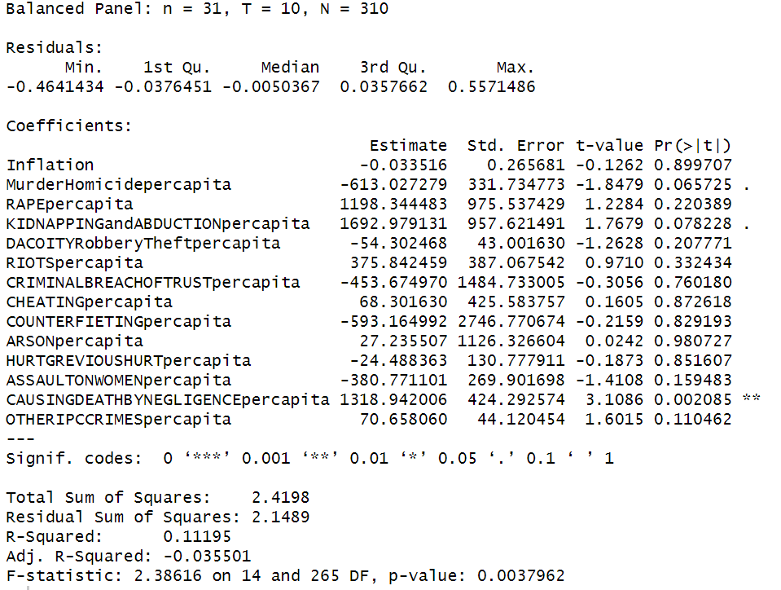
Results
After running fixed effects model regression, we have concluded that only causing death by negligence per capita is significant in the model.
As the p-value is less 0.05, the model is not random and regression done is meaningful.

Slide 11
Random Effects Model
In this model we assume that the unobserved variables are not systematically related to the the observed variables that are included in the model.
GDPgrowthrate _{it} = b₀ + b_{1it*}Inflation _{it} + b_{2it}*MurderHomicidepercapita _{it} + b_{3it}*RAPEpercapita _{it} + b_{4it}*KIDNAPPINGandABDUCTIONpercapita _{it} + b_{5it}*DACOITYRobberyTheftpercapita _{it} + b_{6it}*RIOTSpercapita _{it} + b_{7it}*CRIMINALBREACHOFTRUSTpercapita _{it} + b_{8it}*CHEATINGpercapita _{it} + b_{9it}*COUNTERFIETINGpercapita _{it} + b_{10it}*ARSONpercapita _{it} + b_{11it}*HURTGREVIOUSHURTpercapita _{it} + b_{12it}*ASSAULTONWOMENpercapita _{it} + b_{13it}*CAUSINGDEATHBYNEGLIGENCEpercapita _{it} + b_{14it}*OTHERIPCCRIMESpercapita _{it} + 𝝰_{t} + error _{it}

Slide 12
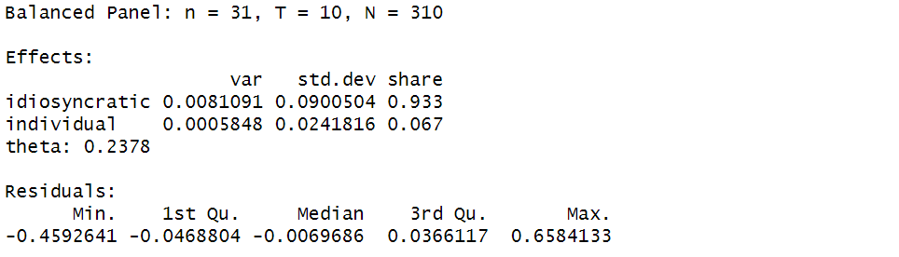
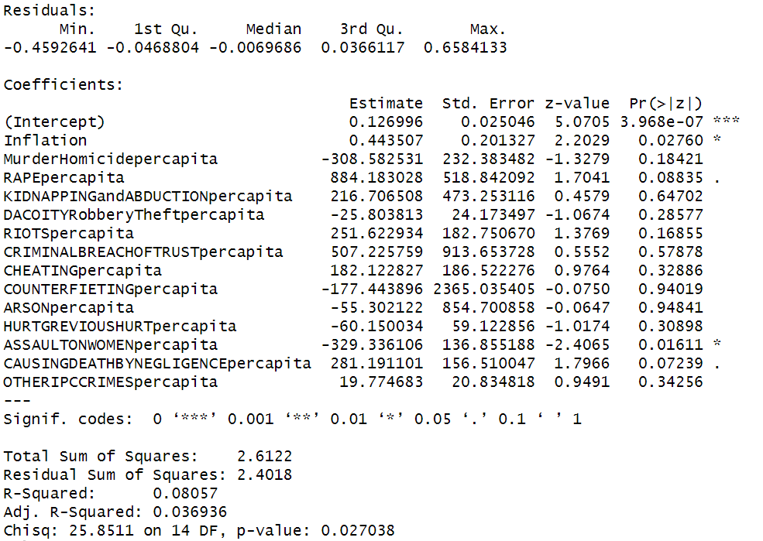
Results
From the regression we can conclude that the inflation and Assault on Women per capita are significant.
The p value of the model is 0.027 which is less than 0.05, hence the model is fit.

Slide 13
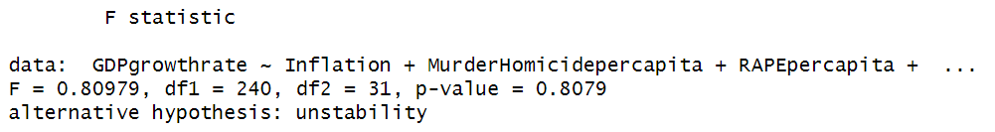
Test for suitable model(pooled ols)
pooltest(GDPgrowthrate~Inflation+MurderHomicidepercapita+RAPEpercapita+KIDNAPPINGandABDUCTIONpercapita+DACOITYRobberyTheftpercapita+RIOTSpercapita+CRIMINALBREACHOFTRUSTpercapita+CHEATINGpercapita,data=pdata, model= "within")
In this model our Null Hypothesis (H0) is that the model is stable and our Alternate Hypothesis (Ha) is model is unstable. From the results the p value of the model is 0.8079 which is greater than 0.05 hence we fail to reject the null hypothesis. Hence, the model is Stable.

Slide 14
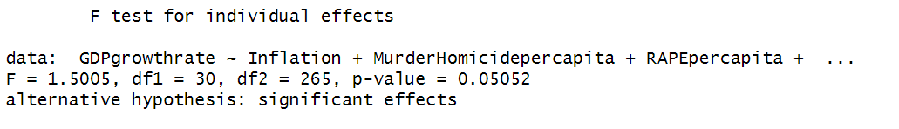
Selection of Pooled OLS or Fixed Effect Model
Command - pFtest(femethod,pooledmethod)
In this model our Null Hypothesis (H0) is that the pooled model is consistent and our Alternate Hypothesis (Ha) is fixed effect model is consistent. From the results the p value of the model is 0.050 which is approximately equal to 0.05 hence we reject the null hypothesis. Hence, the fixed effect model is consistent.

Slide 15
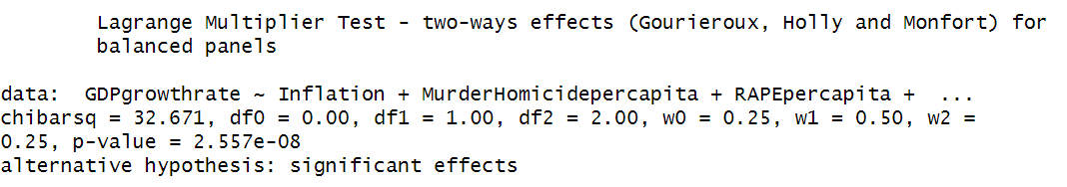
Testing the presence of individual and time effects
In this test the Null Hypothesis (H0) is that there is no significant individual and time effects and our Alternate Hypothesis (Ha) is that there are significant individual and time effects. From the results the p value of the model is less than 0.05 hence we reject the null hypothesis. Hence, there is a significant effect of individual and time effects on the model.

Slide 16
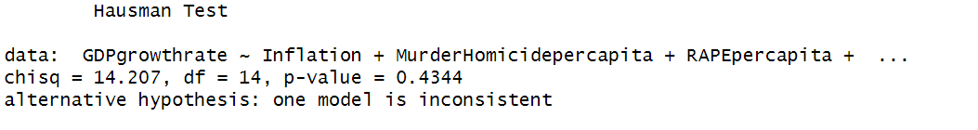
Hausman Test
Through this test we can select which model is to be followed, is it fixed effect model or random effect model
Command- phtest(femethod,remethod)
In this test our Null Hypothesis (H0) is that the random effect model is consistent and our Alternate Hypothesis (Ha) is fixed effect model is consistent. From the results the p value of the model is 0.4344 which is greater than 0.05 hence we fail to reject the null hypothesis. Hence, the random effect model is consistent.

Slide 17
Test for Stationarity
We have performed the unit root test on each independent variable and found that the variables are stationary.
Command- checkMurderHomicidepercapita = data.frame(split(crimedata$MurderHomicidepercapita, crimedata$STATEUT))
purtest(checkMurderHomicidepercapita, pmax = 2, exo = "intercept", test = "levinlin")
Output - Levin-Lin-Chu Unit-Root Test (ex. var.: IndividualIntercepts)
data: checkMurderHomicidepercapita
z = -14.427, p-value < 2.2e-16
alternative hypothesis: stationarity

Slide 18
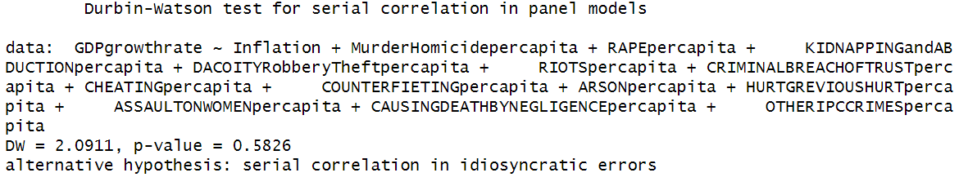
Test for Autocorrelation
We have found presence of serial correlation in the idiosyncratic errors of regression.
In this test our Null Hypothesis (H0) is that there is no autocorrelation in error term and our Alternate Hypothesis (Ha) is there is autocorrelation in error term. From the results the p value of the model is 0.5826 which is greater than 0.05 hence we fail to reject the null hypothesis. Hence, there is no autocorrelation in error terms.

Slide 19
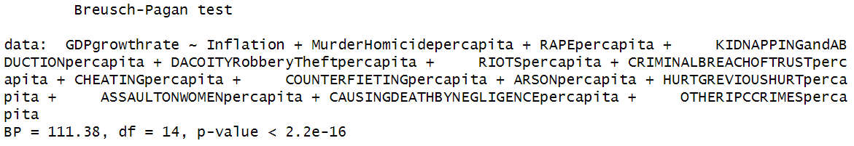
Test for Heteroskedasticity
After doing the Breusch-Pagan test, we have found the presence of heteroskedasticity in the dataset.
In this test our Null Hypothesis (H0) is that there is homoscedasticity and our Alternate Hypothesis (Ha) is there is heteroscedasticity. From the results the p value of the model is less than 0.05 hence we reject the null hypothesis. Hence, there is heteroscedasticity in the model.

Slide 20
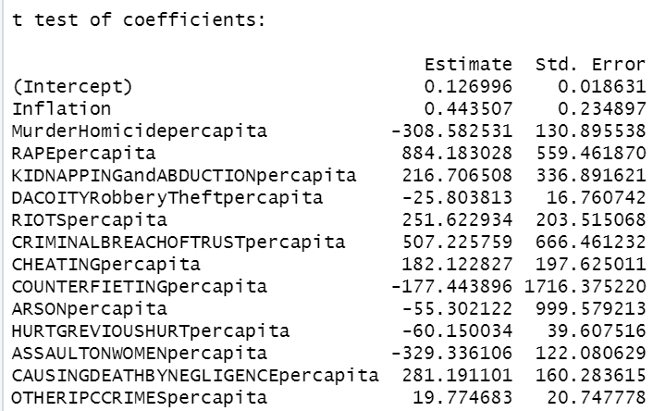
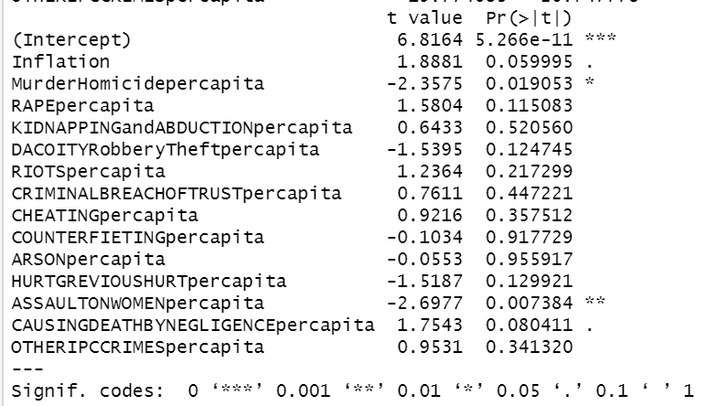
Controlling for Heteroskedasticty and Autocorrelation
We find that Assault on Women Per Capita is significant based on the pe value. Further, Murder and Homicide per capita, Causing death by negligence and Inflation are significant for lower levels of confidence.

Slide 21
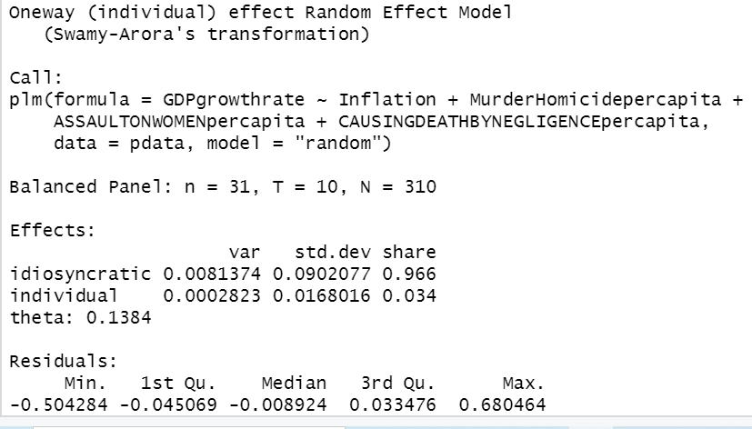
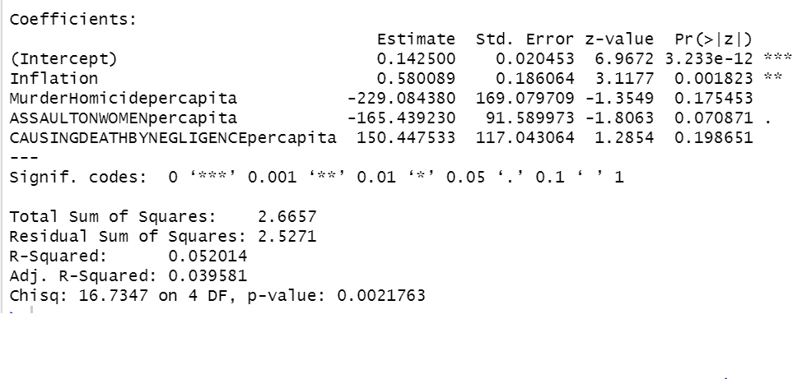
Conclusion
edithedremethod=plm(GDPgrowthrate~Inflation+MurderHomicidepercapita+ASSAULTONWOMENpercapita+CAUSINGDEATHBYNEGLIGENCEpercapita,data=pdata, model="random")
The new model has a lesser value of R-squared which means that the new model is not better than the previous random effect model. The p-value of the regression model has improved. As the independent variables explain less than 10% of the change in explained variable which is GDP growth rate, so it is not giving concrete and actionable insights.

